Slide 1
Communication Skills
MODULE-I
SECTION-I
Communication

Slide 2
Communication Definition
Communication is the transfer of information from one person, group, or place to another by writing, speaking, or using a medium that provides a means of understanding.
Every communication consists of a minimum of one sender, a receiver, and a message.
The transmission of a message from sender to recipient risks being affected by many things because communication impacts how people interact.
These include the location, medium used to communicate, the situation, and the emotions involved. communication helps people to interact and share various aspects of life.

Slide 3
Communication Concept
Communication involves transmitting non-verbal and verbal information in a channel that includes a sender, medium of communication, and a receiver. The following are the essential concepts of communication.
Sender and Receiver
The person sending the information and the one receiving the information must be present for communication to be effective.
The Message
The Idea ,Fact or opinion that the sender want to communicate is the message
Communication works when people hear, see, feel, and understand what a sender is trying to convey.
This ensures that concentration and attention are important allowing for the smooth transfer of information.

Slide 4
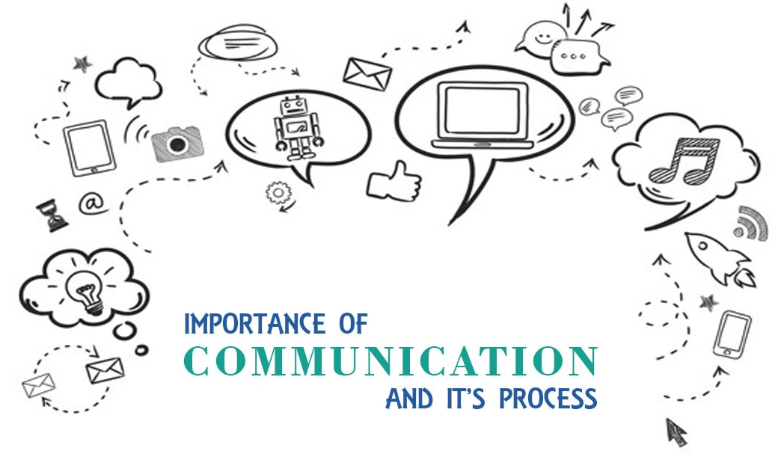
Process and Importance of communication

Slide 5
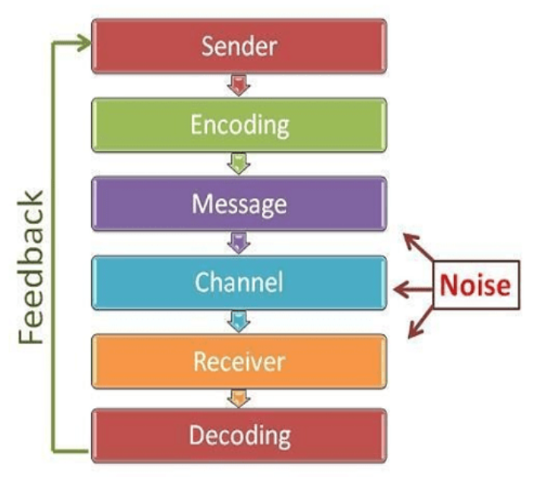
Process of communication

Slide 6
The Communication Process Involves the Following Aspects:
Sender:
The sender is the person who sends the information to the receiver. This is why the communication process has started for the sender.
Encoder:
Encoder encodes the original message into a form which intruder cannot attack it.
Message:
It is the second aspect of the communication process. It is a kind of information that the sender wants to convey to the receiver.
Channel:
It is the medium of sharing information from one person to another. It can be a language or any other. or it simply means various methods of sending the message e.g., telephone, television etc.
Receiver:
The receiver is the person or group who receives the message or information which is sent/given by the sender.
Decoder
A decoder reconverts the message into original form.
Feedback:
Feedback is the key to any effective/successful communication. It is one of the fundamental aspects in the process of communication, through which the sender can understand whether the message has been successfully received or not.

Slide 7
Importance of Communication:
Importance of Communication:
In the Organization:
Communication is the heart of any organization. Everything you do in the workplace is the results of communication.
Communication plays a very important role in the management of any organization.
As it is a tool for sharing thoughts, ideas, opinions and plans in various activities in an organization.
Good communication is required not only in building relationships but also for a successful business. That is why communication is having tremendous importance in the organization.
Communication helps to increase efficiency at the workplace.
Importance for Individuals:
Communication is important to express oneself. It also satisfies one's needs. One should have effective communication for advancement in the career.
In your personal life, effective communication skills can smooth your way and your relationships with others by helping you to understand others, and to be understood.

Slide 8
Importance of Communication
To Secure an Interview:
To secure yourself in the interview you should communicate confidently and clearly. Good communication skills would help you to get selected for the job.
For Motivation:
Communication is a basic tool for motivation. This can improve the morale of the people.
To Increase Productivity:
With effective communication, you can maintain relationships. It helps to increase productivity.
To Develop Professionalism:
In the future students will become doctors and then they need to communicate effectively with their patients. They need empathy, friendliness in their profession for interacting with patients. In the future students will become political / business, entrepreneurs, and leaders, in all these fields they need to communicate effectively.
To Increase the Quality of Being Friendly With Others:
It is important to be friendly with others. Good communication builds strong friendships. It will give confidence. In this way, communication skills enhance the ability to understand and share the feelings of each other. It is important for making friendly relationships.

Slide 9
Models of Communication
There are 8 major models of communication, which can be divided into 3 categories:
Linear models of communication — They only look at one-way communication. The most prominent linear models of communication are:
Aristotle’s communication model,
Lasswell’s communication model,
The Shannon-Weaver communication model, and
Berlo’s S-M-C-R communication model.
Interactive models of communication — They analyze two-way communication. These are the following:
The Osgood-Schramm communication model, and
The Westley and Maclean communication model.
Transactional models of communication — They illustrate two-way communication where the message gets more complex as the communication event progresses. These include:
Barnlund’s transactional communication model, and
Dance’s Helical communication model.

Slide 10
Linear communication models
Linear communication models suggest that communication takes place only in one direction.
The main elements in these models are:
The channel,
The sender, and
The receiver.
Noise acts as the added (background) element that usually distracts the original message.

Slide 11
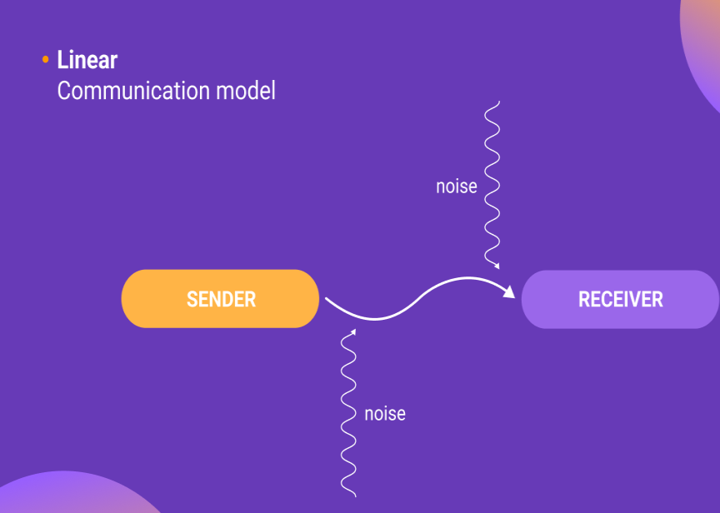
Linear communication models

Slide 12
1.Aristotle’s model of communication
Aristotle’s model of communication primarily focuses on the sender (public speaker, professor, etc.) who passes on their message to the receiver (the audience).
The sender is the only active member in this model, whereas the audience is passive. This makes Aristotle’s communication model a reliable way to excel in public speaking, seminars, and lectures.

Slide 13
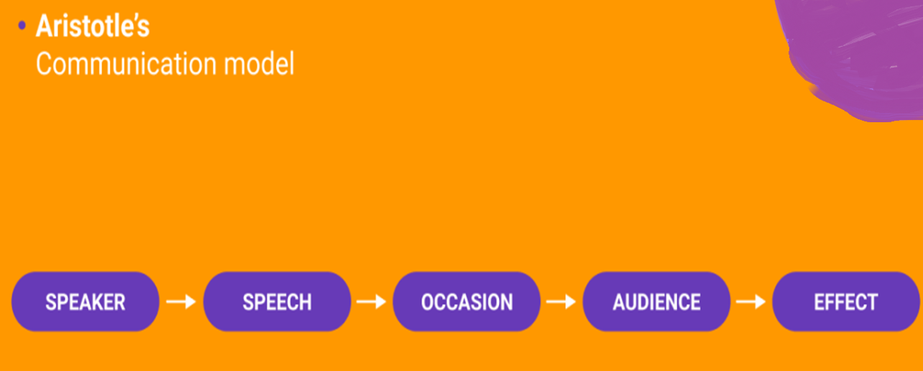
Five Components of Aristotle's communication Model
Aristotle suggested 5 components for best way to communicate:

Slide 14
2.Lasswell’s model of communication
Lass well's communication model views communication as the transmission of a message with the effect as the result.
The effect is the measurable and obvious change in the receiver of the message that is caused by the elements of communication.
If any of the elements change, the effect also changes.

Slide 15
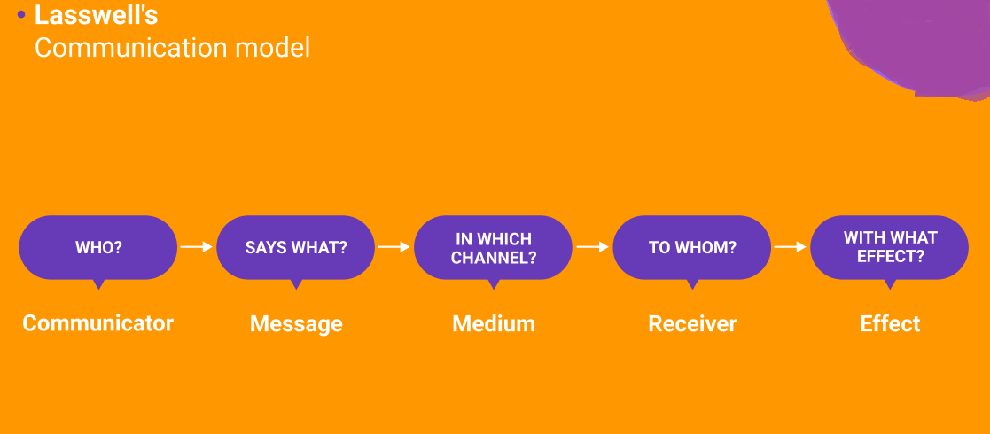
Five components of Lass wells Communication model

Slide 16
Lasswell’s model of communication answers these five questions
Who created the message?
What did they say?
What channel did they use (TV, radio, blog)?
To whom did they say it?
What effect did it have on the receiver?

Slide 17
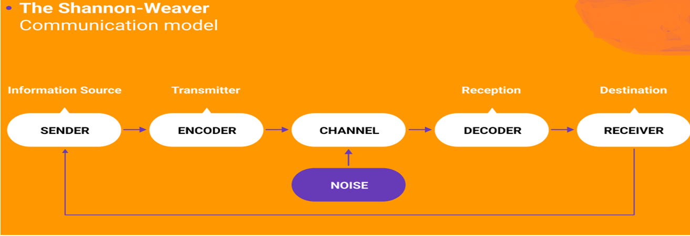
3. The Shannon-Weaver model of communication
The Shannon-Weaver communication model, therefore, is a mathematical communication concept that proposes that communication is a linear, one-way process that can be broken down into 5 key concepts.

Slide 18
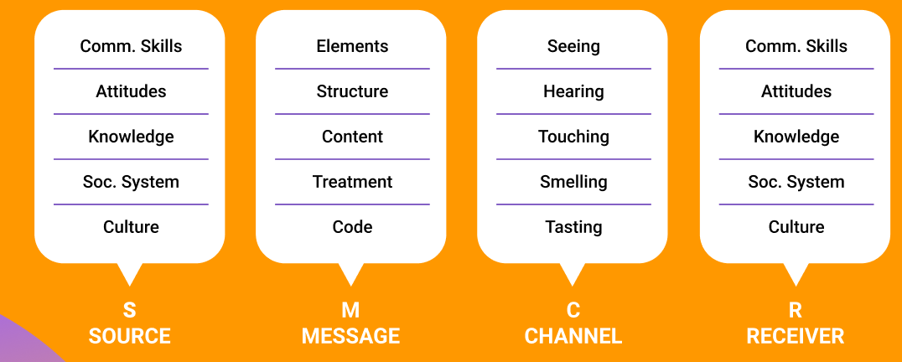
4.Berlo’s S-M-C-R model of communication
Berlo’s S-M-C-R communication model is a linear model of communication that suggests communication is the transfer of information between 4 basic steps or key elements.

Slide 19
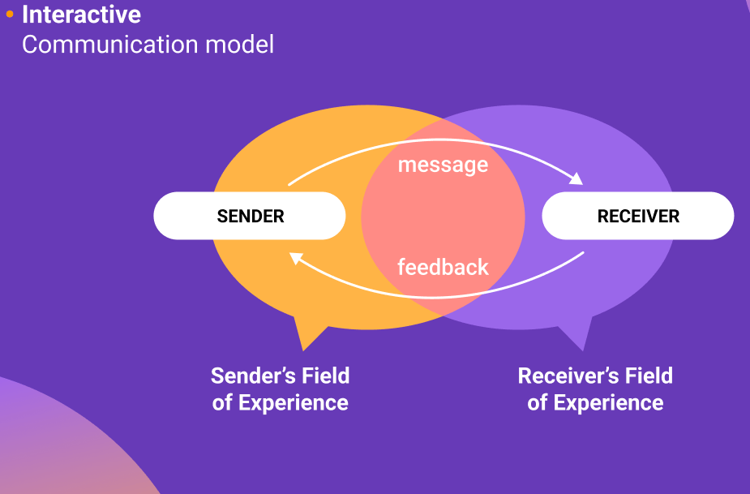
Interactive communication models
Interactive communication models refer to two-way communication with feedback.
However, feedback within interactive communication models is not simultaneous, but rather slow and indirect.
Field of Experience: It refers to the person’s(communicator) culture, past experience, personal history

Slide 20
5. The Osgood-Schramm model of communication
The Osgood-Schramm model is a circular model of communication, in which messages go in two directions between encoding and decoding.
As such, this model is useful for describing synchronous, interpersonal communication, but less suitable for cases with little or no feedback.
Interestingly, in the Osgood-Schramm communication model, there is no difference between a sender and a receiver. Both parties are equally sending the messages.
The interpreter is the person trying to understand the message at that moment.

Slide 21
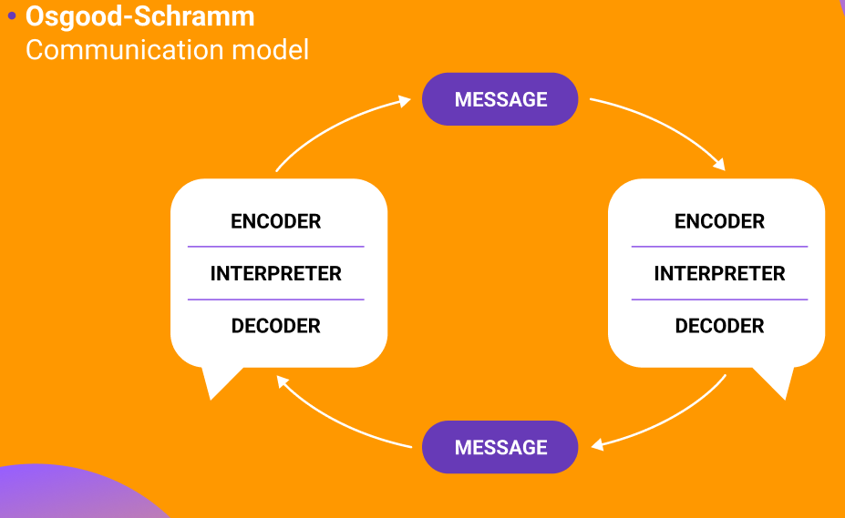

Slide 22
6. The Westley and Maclean model of communication
The Westley and Maclean communication model suggests that the communication process does not start with the source/sender, but rather with environmental factors.
This model also takes into account the object of the orientation (background, culture, and beliefs) of the sender and the receiver of messages.
The process of communication, according to this communication model, starts with environmental factors that influence the speaker — the culture or society the speaker lives in, whether the speaker is in a public or private space, etc.
Aside from that, the role of feedback is also significant.

Slide 23
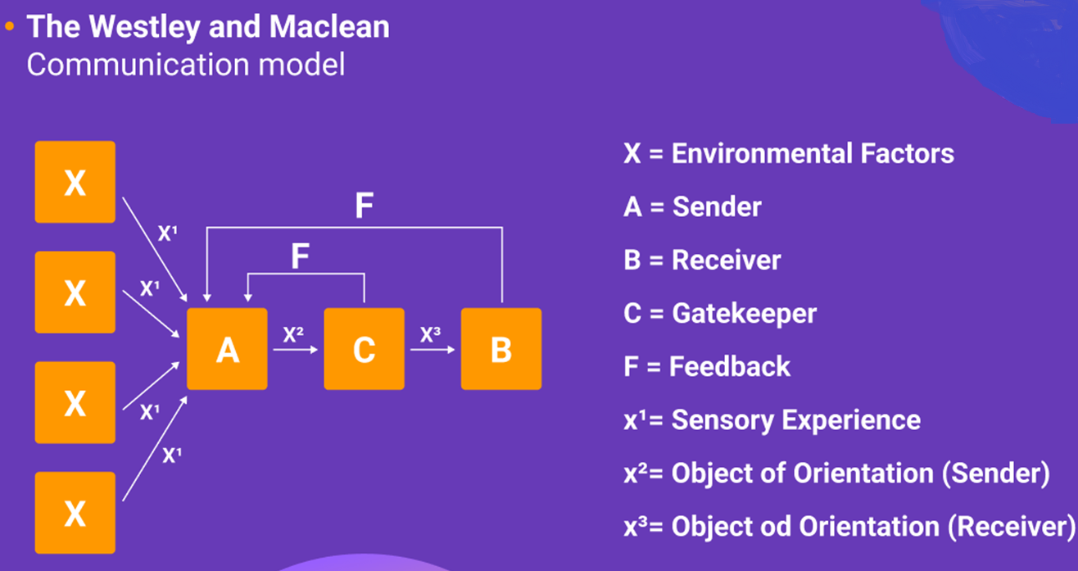

Slide 24
Transactional communication models
Transactional communication models view communication as a transaction, meaning that it is a cooperative process in which communicators co-create the process of communication, thereby influencing its outcome and effectiveness.
In other words, communicators create shared meaning in a dynamic process.

Slide 25
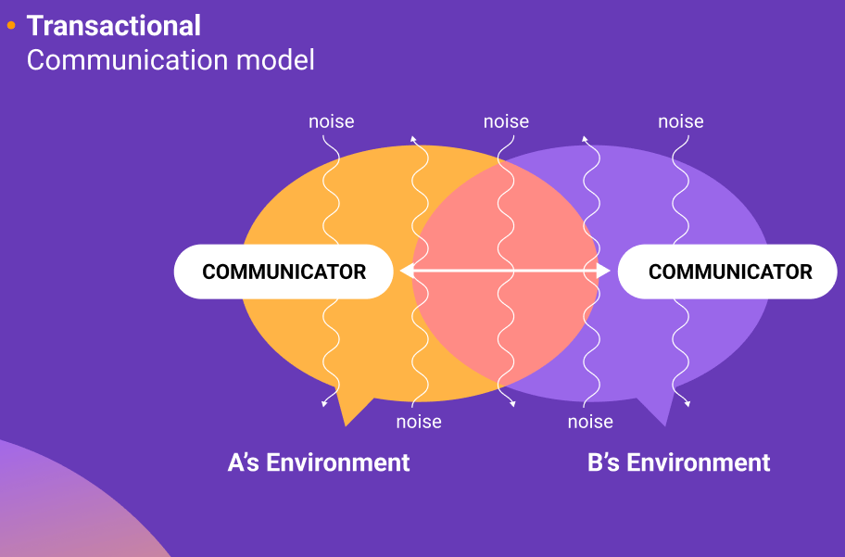

Slide 26
Key components of transactional model are
Encoding,
Decoding,
Communicators,
The message,
The channel, and
Noise.

Slide 27
7. Barnlund’s transactional model of communication
Barnlund’s model of communication recognizes that communication is a circular process and a multi-layered feedback system between the sender and the receiver, both of whom can affect the message being sent.
The sender and the receiver change their places and are equally important. Feedback from the sender is the reply for the receiver, and both communicators provide feedback.
At the same time, both sender and receiver are responsible for the communication’s effect and effectiveness.

Slide 28
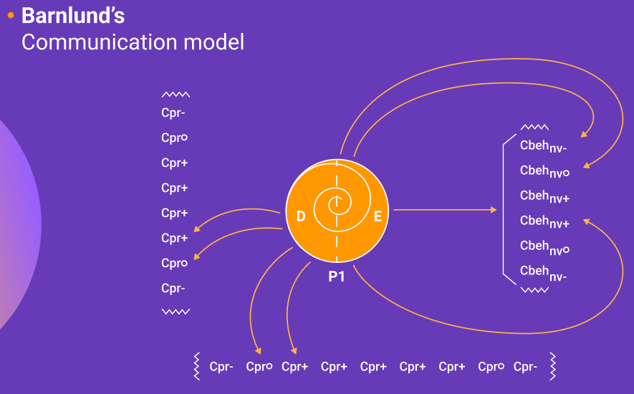

Slide 29
8. Dance’s Helical model of communication
Dance’s Helical communication model views communication as a circular process that gets more and more complex as communication progresses.
That is why it is represented by a helical spiral in the Dance’s Helical communication model

Slide 30
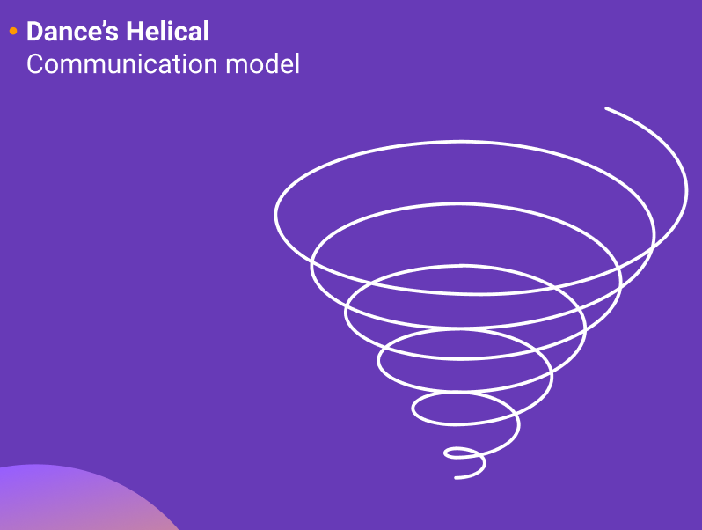

Slide 31
Types of Communication
The types of communication represent the different ways used to communicate messages.
6 Types of Communication
1. Verbal Communication
2. Non-verbal Communication
3. Written Communication
4. Visual Communication
5. Oral Communication
6. External Communication

Slide 32
Types of Communication continue..
1. Verbal Communication
Through spoken words and the use of speech and language to convey messages. It occurs when we speak to others. Verbal communication can be formal and informal. However, when it takes place in person, verbal communication and non-verbal communication go together.
2. Non-verbal Communication
Body language, facial expressions, eye contact, appearance, and sign language. Non-verbal communication complements verbal communication and also helps when words don’t help. It is an important type of communication in interviews and discussions as they value it a lot.

Slide 33
3. Written Communication
The use of written words to convey messages. Written communication happens through email, memos, texts, posts, etc. While written communication helps you share your thoughts well, sometimes it does not fully convey the emotion that you are trying to share.
Listening
Listening is one of the most important parts of communication as it helps you understand the perspective of the communicator and effectively engage with them. The process of any communication places a crucial value on listening correctly and responding appropriately.

Slide 34
Types of Communication continue..
4. Visual Communication
Through visual messages like pictures, graphs, objects and other visual facets. Visual Communication is a crucial part of today’s methods of conveying important information. It is used in presentations, televisions, etc.
5. Aural Communication
Aural communication involves the sense of hearing. It consists of different forms of communication that rely on spoken words, sounds, and other auditory cues. Aural communication involves spoken words, non-verbal elements such as tone of voice, pitch, and rhythm, good listening skills, content and delivery of speech, etc.

Slide 35
Types of Communication continue..
6. External Communication
External communication refers to the transmission of information and data in and outside an organization. This external mode of communication involves entities like customers, suppliers, partners, investors, regulatory bodies, the media, and the general public.

Slide 36
Modes of communication
The modes of communication focus on the mediums in which our message is communicated.
Interpretative Communication
Presentational Communication
Interpersonal Communication
Linguistical Communication
Gestural Communication
Oral Communication
Visual Communication
Spatial Communication
Multimodal Communication

Slide 37
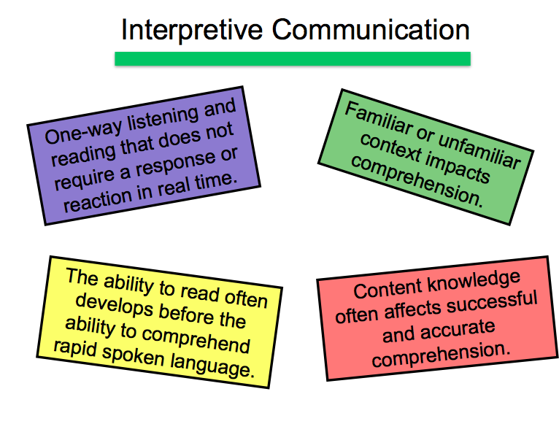
1. Interpretive Communication
1. Interpretive Communication

Slide 38
Modes of communication continue…
1.Interpretative communication
It is also referred to as “one-way communication”.
In this mode, the information conveyed by the sender is interpreted by the receiver in its original form.
The target has to understand the message in both written and spoken form keeping various aspects in mind.
For example, in a class, the learners may not understand every word said by the teacher but are expected to understand the main crux of the topic.
Learners understand, interpret, and analyze what is heard, read, or viewed on a variety of topics.

Slide 39
2. Interpersonal Communication
Interpersonal communication is the process by which people exchange information through verbal and nonverbal messages.
It is an unmediated mode of communication that occurs when we interact and mutually influence each other in order to manage relationships.
Although interpersonal communication can encompass oral, written, and non-verbal forms of communication, the term is usually applied to spoken communication that takes place between two or more individuals on a personal or face-to-face level.
Examples of Interpersonal Communication include:
Personal Interview
Telephonic Conversations
Interactive Sessions
E-mails
Text Messages

Slide 40
Modes of communication continue…
3.Presentational Communication
Presentational Communication is another type of one-way communication.
With this mode of communication, a person is speaking to an audience that can be rehearsed, pre-prepared, or scripted.
To ensure the intended audience is successful in its interpretation, the “presenter” needs knowledge of the audience’s language and culture.

Slide 41
Modes of communication continue…
4. Linguistical or Alphabetic Communication
As one of the popular modes of communication, Linguistical or Alphabetic Communication mainly refers to written or spoken communication where the sender conveys their message through writing on paper or through speaking. Examples: Text messages, audio messages, emails, speech, notes and lists, etc.
5. Gestural Communication
Gestural Communication has its quint essential emphasis on body language and physical movements to communicate messages.
Sign Language is the best example of the gestural mode of communication as those who can’t talk or hear are able to communicate best through their gestures and have their own set of unique languages to converse.
While this mode of communication is mainly combined with spatial, aural or linguistic ones, it can also be used individually given that both the sender and receiver have common points of reference and meanings to have an understandable communication.

Slide 42
Modes of communication continue…
6. Oral Communication
As the name suggests, oral communication uses audio mode to convey messages whether it is through sounds or spoken audio. The speaker’s voice and pronunciation need to be clear and precise with no background noise. Examples: Radio, audio messages, music, recordings, songs, audiobooks.
7. Visual Communication
Visual Communication can be simply termed non-verbal communication as it comprises visual messages from the sender to the receiver. It is one of the oldest modes of communication when the ancient people didn’t know a language to communicate with, it is through pictures, drawings and symbols that they were able to talk and converse with each other. Examples: Pictures, Videos, Charts, Graphs, Symbols
8. Spatial Communication
Spatial Communication elaborates upon the use of physical space in the text as well as its overall structure to convey certain meanings and messages. The effect of spacing ,physical distancing, positioning. It is also known as proxemics meaning closeness.

Slide 43
Modes of communication continue…
9.Multimodal Communication
Multimodal Communication can be simply referred to as communication through varied modes such as verbal, written, gestures, etc. There are different modes of multimodal communication and it is popularly used in higher education to accentuate the learning experience for students.
******************************************************

Slide 44
Objectives of communication
1. Transmitting Information : The objective of transmitting information is to ensure the accurate and timely delivery of information to inform and update stakeholders.
Effective communication allows for the smooth flow of information, ensuring that all relevant parties receive the necessary details.
For example, a project manager may use communication channels such as team meetings, emails, or project management tools to transmit information about project milestones, deadlines, and progress updates to all team members. This objective ensures that everyone has access to the information needed to perform their roles effectively.
2. Building Relationships : The objective of building relationships is to foster positive connections, trust, and mutual understanding with individuals or groups.
Effective communication is essential for establishing and nurturing strong relationships. Building relationships involves active listening, empathy, and open dialogue to create a sense of connection and trust.
For instance, a sales representative may focus on building relationships with clients through regular communication, understanding their needs, and providing personalized solutions. By fostering strong relationships, trust is built, leading to long-term partnerships and increased customer loyalty.

Slide 45
Objectives of communication Continue..
3. Influencing Others :
The objective of influencing others is to persuade and inspire individuals or groups to adopt new perspectives, attitudes, or behaviors.
Effective communication can be a powerful tool for influencing others and driving change. Whether it’s encouraging employees to embrace a new company vision, convincing customers to try a new product.
An example of influencing others through communication is seen in marketing campaigns. Marketers utilize persuasive messaging, compelling storytelling, and emotional appeals to influence consumer behavior and drive purchasing decisions.
4. Resolving Conflicts :
The objective of resolving conflicts is to facilitate open dialogue and effective communication to address and resolve conflicts.
Conflict is a natural part of any relationship or organization. Effective communication helps in managing conflicts by promoting understanding, empathy, and finding common ground for resolution.
For instance, a team leader may facilitate a conflict resolution discussion where team members can openly express their concerns, listen to each other’s perspectives, and work together to find mutually agreeable solutions. Through effective communication, conflicts can be resolved, fostering a harmonious and productive work environment.
5. Sharing Ideas :
The objective of sharing ideas is to encourage the exchange of innovative ideas, promoting creativity and collaboration.
Effective communication encourages individuals to share their unique perspectives, insights, and ideas. By creating an open and supportive environment, organizations can tap into the collective intelligence of their team members, leading to innovation and growth.

Slide 46
Objectives of communication continue….
6. Delivering Feedback : The objective of delivering feedback is to provide constructive feedback to facilitate personal and professional growth. Effective communication involves providing feedback that is specific, timely, and actionable. Feedback plays a crucial role in enhancing performance, developing skills, and fostering continuous improvement.
For instance, a manager might provide feedback to an employee on their presentation skills, highlighting areas of improvement and offering suggestions for enhancing their delivery. By delivering feedback effectively, individuals can learn, grow, and achieve their full potential.
7. Building Trust : The objective of building trust is to establish credibility, reliability, and trust through transparent and authentic communication. Trust is the foundation of strong relationships, both in personal and professional settings. Transparent and authentic communication builds trust by demonstrating honesty, integrity, and consistent messaging.
For example, leaders who communicate openly about organizational changes, challenges, and successes establish trust among employees. By fostering a culture of trust, organizations can cultivate a positive work environment and enhance employee engagement.
8. Enhancing Collaboration : The objective of enhancing collaboration is to facilitate effective collaboration and teamwork through open and inclusive communication. Collaboration is essential for achieving shared goals and driving innovation. Effective communication enables teams to work together seamlessly, share knowledge, and leverage diverse perspectives.
For instance, project teams utilize collaborative communication tools, such as project management software or online platforms, to foster real-time collaboration, streamline workflows, and ensure that everyone has access to relevant project information. This objective enhances productivity, efficiency, and overall team performance.

Slide 47
Objectives of communication continue….
9. Motivating and Inspiring : The objective of motivating and inspiring is to energize and inspire individuals or teams through effective communication.
Motivating and inspiring communication boosts morale, engagement, and motivation. By effectively conveying a compelling vision, setting clear goals, and recognizing achievements, leaders can inspire individuals to reach their full potential.
For example, a CEO delivering an inspiring speech at a company-wide event can motivate employees by sharing the company’s vision, acknowledging their contributions, and expressing confidence in their abilities. This objective fosters a sense of purpose and commitment among employees.
10. Empowering and Engaging : The objective of empowering and engaging is to encourage active participation, involvement, and empowerment through communication.
Empowering and engaging communication involves creating a culture where individuals feel valued, heard, and encouraged to contribute. It promotes autonomy, ownership, and a sense of belonging.
For instance, leaders who delegate responsibilities, involve employees in decision-making processes, and provide opportunities for growth empower their teams. This objective fosters a sense of empowerment, leading to increased job satisfaction and productivity.
By incorporating these objectives into your communication strategies, you can maximize the impact of your interactions, foster meaningful relationships, and drive success in both personal and professional endeavors.

Slide 48
Barriers of communication
Physical Barriers The physical barriers affect both verbal and non-verbal communication. These barriers are present around us in the environment, such as noise, technical problems, design problems, etc.
Attitude Barriers The attitude barriers can arise due to overconfidence, poor management, lack of motivation, and behavior. Attitude barriers prevent people from communicating effectively with others. Such types of persons are less likeable. These barriers arise due to a lack of understanding that can cause a person to misjudge and ignore another person. Respectful, polite, and pleasant behavior helps us move upward in the workspace with increased sales and productivity.
Emotional Barriers The emotions in a person determine the ease and comfort in which he/she can communicate. It arises due to a lack of emotional intelligence. A better understanding of inner emotions will help us to respect the emotions of other people. Overcoming emotional barriers is an essential skill for effective communication.
Cultural Barriers Cultural barriers usually exit between countries, religions, caste, color, etc. at any level in society or an organization. Different people have different values, body language, gestures, beliefs, and behavior. We should not underestimate any culture or religion.

Slide 49
Barriers of communication
Language Barriers Language barriers are also known as linguistic barriers. A small variation in language can lead to colossal misunderstanding between people. It is recommended to use simple language and words while communicating.
Gender Barriers Gender barriers signify how men and women behave; such barriers include different choices, styles of decision-making, etc. Women prefer to discuss the problems verbally. Overcoming gender barriers are essential to maintain equality in the workspace.
Lack of focus and eye contact Lack of focus and eye contact may lose the interest of listeners or audience. Lack of focus can be due to any reason, such as improper sleep, overworking hours, alcohol, stress, etc.
Fear of mistakes Mistakes are a part of the communication process. The practice is the best key to reduce our mistakes; We can practice exercises to improve our communication skills. Always try to learn from the mistakes. For example, We sent an email to someone with some mistakes. Do not fear. Instead, again write an email with the text, "Sorry for the mistake. Please, ignore that email and consider the below email." In the above example, we can rewrite the email.

Slide 50
Barriers of communication
Psychological Barriers The psychological state of a person can be a barrier in communication, such as opinion, consciousness, emotions, attitude, and behaviour. It distracts the user form paying attention while communicating. For example, a person will low confidence or self-esteem may not respond appropriately while talking to the superior.
Perceptual Barriers Perceptual barriers are the barriers that prevent a person from correct predictions about others, such as expectations. It depends on how we analyze the things around us to recognize any information. The best way to overcome such barriers is to find a positive solution.
Feedback Issues Feedback ensures that the receiver has correctly interpreted the message from the speaker/sender.

Slide 51
Interpersonal and Intrapersonal communication
Sr. No | Intrapersonal Communication | Interpersonal Communication
1. | Communication within oneself | Communication between two or more individuals
2. | Self-reflection and internal dialogue | Verbal and non-verbal interaction between people
3. | Solitary process | Social and interactive process
4. | Internal thoughts, emotions, and self-analysis | Exchange of ideas, information, and emotions
5. | Examples: self-talk, thinking, reflection | Examples: conversations, discussions, negotiations

Slide 52
Interpersonal and Intrapersonal communication continue..
6. | Self-awareness and self-expression | Building relationships and understanding others
7. | Limited to one's own perspective and experiences | Involves multiple perspectives and diverse experiences
8. | Does not require external feedback | Relies on feedback from others
9. | Non-interactive | Interactive and dynamic
10. | Internal decision-making and problem-solving | Collaboration and conflict resolution

Slide 53
Commandments of communication
Listen First:
To communicate in a way that others understand, you have to learn what's on their minds, first. That's why listening is so important.
Active listening involves asking questions, along with concentrated effort to understand others answers--all while resisting the urge to judge.
When you regularly and skillfully listen to others, you stay in touch with their reality. You become quickly aware of the other person's highs and lows, and how they are dealing with them. Further, you send the message that what's important to them.

Slide 54
Commandments of communication continue…
Show empathy.
When others tell you their story, endeavor to understand their thought process and see the world from their perspective. (This is called cognitive empathy.)
focus on the positive.
Dwelling on the negative in others is a sure fire way to breed contempt and close someone's ears to your own message. Therefore, focus on the positive in others.
Laying this foundation first makes others more willing to hear dissenting or (constructively) critical opinions later.
* Be Sincere.
When praising, don't flatter or praise superficial qualities.
Be genuine regarding what you appreciate about others. When sharing negative feedback,communicate out of a desire to help--and that motive will become obvious to others.

Slide 55
Commandments of communication continue…
Be specific.
People aren't mind-readers. Therefore, don't just tell others you appreciate them . Tell them specifically what you appreciate, or what needs to change--and why. ( if it's negative, communicating with tact and grace will make your message easier to accept.)
Be Respectful.
You earn respect when you show it to others, first.
Acknowledge others when you see them by giving a smile and nod of the head, or a simple hello. When speaking, avoid sarcasm and cutting remarks, which beg for negative emotional reactions. Instead, speak to others the way you want them to speak to you.
pause.
"The pause" is as simple as taking a moment to stop and think before you speak, especially if you're in a highly emotional state. It may sound simple, but while easy in theory, it's highly difficult to practice consistently.
But if you learn from mistakes and continue to improve, the pause will help you avoid embarrassment, prevent regrets, and save countless relationships.

Slide 56
Commandments of communication continue…
Be transparent.
There's nothing worse than the feeling that someone is keeping a secret from you.
Transparency doesn't mean sharing everything about yourself, to everyone, all of the time.
But it does mean saying what you mean, meaning what you say, and sticking to your values and principles above all else.
Know when to yield.
Resist the urge to attack every opinion or statement you don't agree with.
Remember that people are emotionally attached to their beliefs. If you mercilessly expose every flaw in others reasoning, even if you're right, he will feel attacked and close his mind to whatever you have to say.
Be consistent.
To be effective, communication must continue to flow. Make time for others by communicating in various forms, such as in person, telephone, or through written messages .
Everyone's busy, so make sure you schedule time to simply talk and catch up with others. The more important the relationship, the more often you should be having those one-on-one conversations.

Slide 57
Thank you

